Slide 1
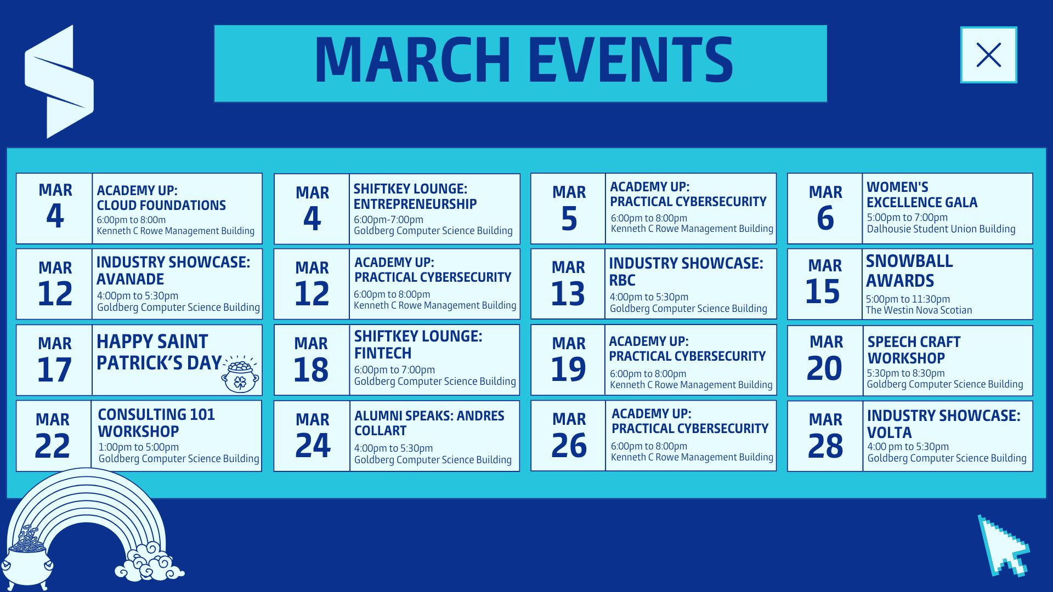

Slide 2
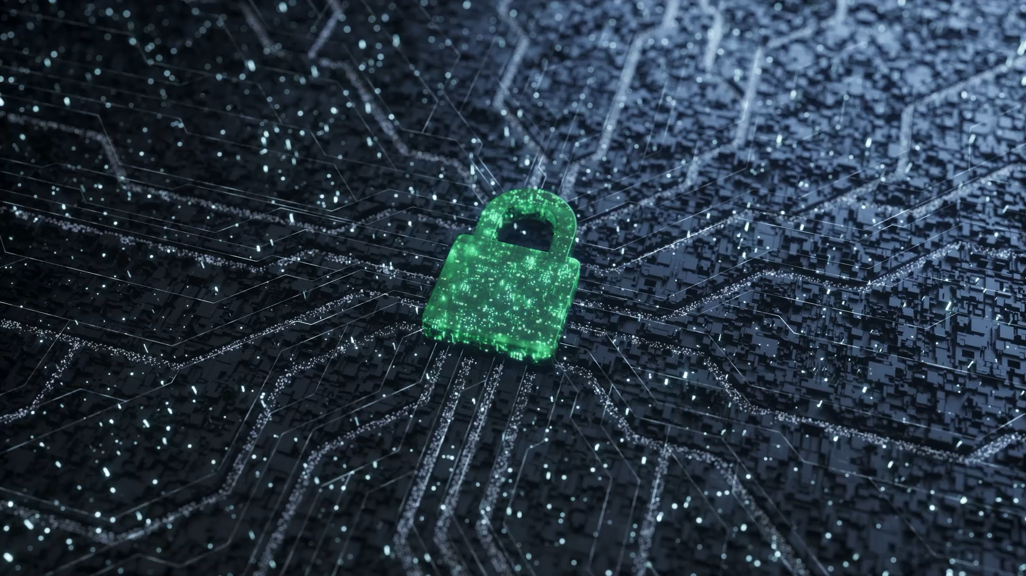
Practical Cybersecurity
Instructor – Aman Bhalla

Slide 3
Course Syllabus
Week 1: Introduction to Cybersecurity
What is cybersecurity, and why does it matter?
Common cyber threats (malware, phishing, ransomware).
Understanding attack vectors (social engineering, network attacks).
Hands-on Activity: Phishing Email Analysis.
Week 2: Network & Data Security
Basics of firewalls, intrusion detection, and secure communication.
Encryption fundamentals (symmetric vs. asymmetric).
Best practices for authentication (MFA, password security).
Hands-on Activity: Team Activity (TBA)
Week 3: Application Security & Cyber Defense
Secure software development practices & common vulnerabilities.
OWASP Top 10 (SQL Injection, Cross-Site Scripting).
Incident response planning & threat intelligence basics.
Cybersecurity Frameworks
Hands-on Activity: Web Application Scanning with OWASP ZAP.
Week 4: Ethical Hacking & Exam Prep
Basics of penetration testing & reconnaissance techniques.
Cyber laws, ethical responsibilities in hacking.
Hands-on Activity: Reconnaissance Exercise & Case Study.
Exam format overview & revision session.

Slide 4
Course Schedule & Assessment
Course Meeting Schedule:
Time: Wednesdays, 6:00 - 8:00 PM
Location: Rowe 1020
Session Dates:
Week 1: March 5th
Week 2: March 12th
Week 3: March 19th
Week 4: March 26th
Final Assessment (April 2nd)
The final assessment will be held in-person.
Exam format: MCQs, Short Answer, and Long Answer Questions.
More details on the exam structure will be announced in Week 4.
Important Notes:
Attendance is highly recommended to maximize learning.
Minimum of 3 sessions need to be attended to qualify for the certification.
Hands-on activities will directly help in assessment preparation.
Reach out if you have any questions or need extra resources!

Slide 5

Grade Breakdown
Assessment Components:
Lecture Quizzes (4 total) (Held Every Week)
Each quiz is worth 2.5%
Total: 10%
Team Assignment (In-Class, Week 2)
Worth 10%
Final Exam (In-Person on April 2nd)
Worth 80%
Course Passing Requirement:
Minimum passing percentage: 80%

Slide 6

What is Cybersecurity?
Cybersecurity is the practice of protecting networks, devices, and data from unauthorized access, attacks, and damage. It ensures that information remains confidential, accurate, and accessible to authorized users. At its core, cybersecurity is built on the CIA Triad:
Confidentiality: Only authorized users can access sensitive data.
Integrity: Ensuring data is not altered or tampered with by unauthorized users.
Availability: Keeping data and systems functional and accessible at all times.

Slide 7

Why Cybersecurity Matters?
Cybercrime is a growing global threat, affecting businesses, governments, and individuals. In 2023 alone, cybercrime cost the world over $8 trillion. Common attacks include data breaches, ransomware, and fraud that lead to financial losses and reputational damage.
Every 39 seconds, a cyberattack occurs worldwide.
Over 80% of hacking attacks exploit weak passwords or outdated software.
Small businesses are frequent targets—60% go bankrupt within six months of a major cyberattack.
Example: In 2021, the Colonial Pipeline ransomware attack shut down the U.S. fuel supply, showing the real-world consequences of poor cybersecurity.

Slide 8

Common Cyber Threats
There are various types of cyber threats that individuals and organizations face:
Malware: Malicious software that infects systems (e.g., viruses, trojans, worms).
Phishing: Deceptive emails that trick users into providing sensitive information.
Ransomware: Hackers encrypt data and demand payment for decryption.
Man-in-the-Middle (MITM) Attacks: Cybercriminals intercept communication between two parties to steal data.

Slide 9
Phishing Attacks – The Silent Threat
Fake emails impersonating trusted sources

Slide 10
Phishing Attacks – The Silent Threat
Fake emails impersonating trusted sources
Suspicious links leading to credential theft

Slide 11
Phishing Attacks – The Silent Threat
Fake emails impersonating trusted sources
Suspicious links leading to credential theft
Poor grammar, urgent requests, and unknown senders are warning signs

Slide 12
Phishing Attacks – The Silent Threat
Fake emails impersonating trusted sources
Suspicious links leading to credential theft
Poor grammar, urgent requests, and unknown senders are warning signs
Example: “Your account is locked! Click to verify”

Slide 13

Practical Activity – Phishing Email Analysis
Visit Google’s Phishing Quiz and analyze sample emails.
Identify red flags like fake domains, urgency, and typos.
Link to website: https://phishingquiz.withgoogle.com

Slide 14

Understanding Attack Vectors
Attack vectors are entry points that hackers use to exploit vulnerabilities:
Social Engineering: Manipulating people into revealing passwords or installing malware.
Network-Based Attacks: Exploiting weak Wi-Fi security and unpatched systems.
Insider Threats: Employees or contractors intentionally or accidentally leaking data.
Example: A hacker pretending to be IT support calls an employee, claiming they need to reset their password. If the employee shares their credentials, the attacker gains access.

Slide 15

Cybersecurity Best Practices
Use Strong, Unique Passwords – A mix of uppercase, numbers, and special characters.
Enable Multi-Factor Authentication (MFA) – Extra security beyond passwords.
Avoid Clicking Suspicious Links – Always hover over links before clicking.
Keep Software Updated – Security patches prevent attacks.
Example: 81% of hacking-related breaches are due to weak or stolen passwords.

Slide 16
Discussion & Q&A
What is the biggest cybersecurity threat you have encountered?
How do you protect yourself online?
Have you or anyone you know faced a cyber attack?

Slide 17
Key Takeaways
Cybersecurity is a global concern affecting businesses & individuals.
Phishing, malware, and ransomware are major security threats.
Attack vectors include social engineering, network vulnerabilities, and insider threats.
Awareness, strong passwords, and multi-factor authentication are key to online safety.
Final Thought: Cybersecurity isn’t just an IT issue—it’s a life skill in today’s digital world.

Slide 18

Quiz Time!
Time Limit – 15 Minutes. Quiz begins at 7:45 pm and will close at 8:00 pm.
Questions: MCQ’s, True or False and Short Answer.

Slide 19
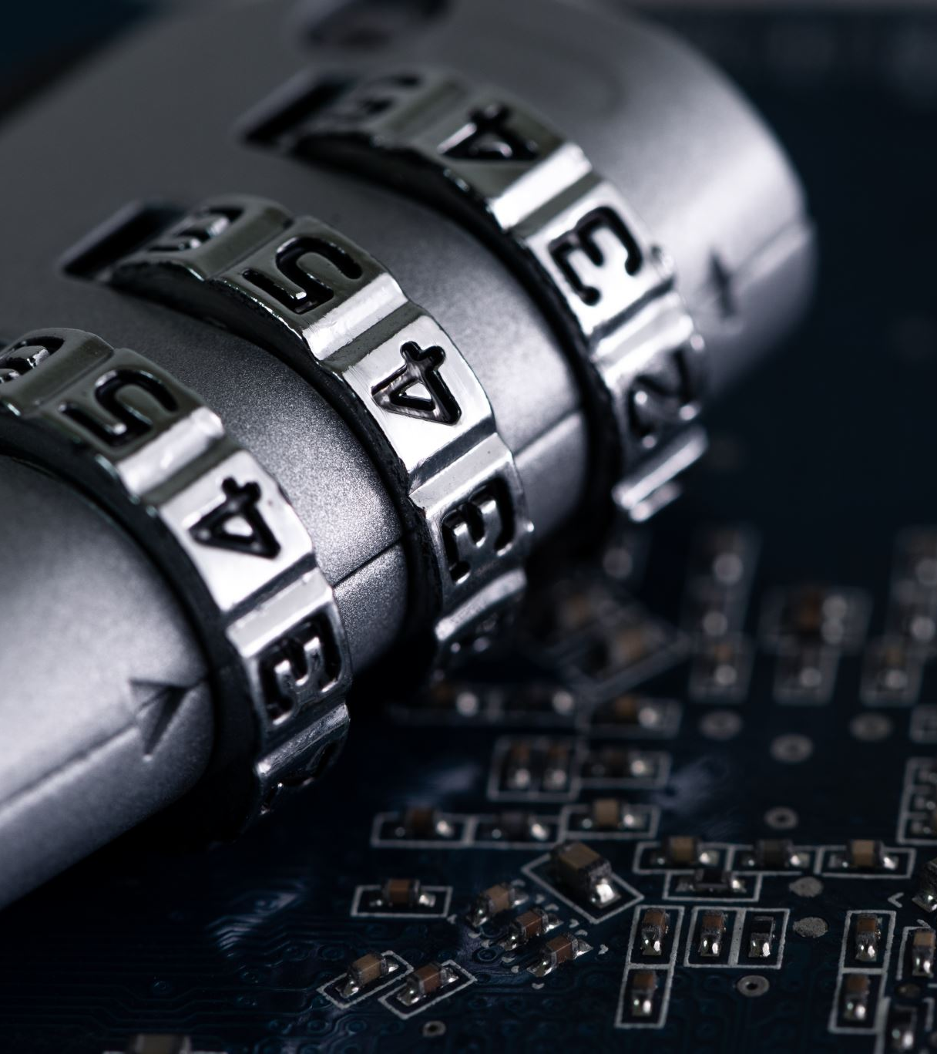
Next Week Preview
Preview of Week 2 Topics:
Firewalls & Intrusion Detection Systems (IDS/IPS) – Blocking cyber threats.
Secure Communication Protocols (HTTPS, SSL/TLS) – Keeping data safe online.
Encryption & Hashing Basics – Protecting sensitive data.
Next week, we’ll talk about what tools hackers may use to crack passwords and how we can use encryption to keep data secure.

